Slide 1



Crime in Boston Analysis (2015-2020)
Joshua Keller : July 6, 2022

Slide 2
The Problem
Boston is no stranger to crime, but to what extend is the crime rate getting better. This data analysis is meant to show what crimes are being committed, the difference by year, and any other discoveries along the way.

Slide 3
Some Questions to be Answered
Have Incidents Gone Down with Time?
What are the top 5 Incidents Across 2015-2020?
Why was Crime at an all Time High During 2017?
Have Shootings Increased in Boston?
What is the Worst day to go out in Boston? What is the Best Day?
What are the Top 5 Worst Districts, Reporting Areas, and Streets in Boston?

Slide 4
Have Incidents Gone Down with Time?
It appears that crime rate was on a rise until 2017, and then a decline from 2017 to 2020.
My first thought was to find the number of shootings that occur ever year in Boston. It appears that Boston shootings have grown at an approximate average growth rate of 20.09%. However, the probability of a shooting being involved in an incident is .005 or .5%. This is nowhere near any statistical significance, so I moved my thoughts to overall incidents by year.

Slide 5
What are the top 5 Incidents Across 2015-2020?
What are the top 5 incidents across 2015-2020?
Year | Offense Code | Code Breakdown
2020 | 3301 | Verbal Dispute
2019 | 3006 | Sick / Injured / Medical
2018 | 3006 | Sick / Injured / Medical
2017 | 3115 | Investigating Person
2016 | 3115 | Investigating Person
2015 | 1402 | Vandalism

Slide 6
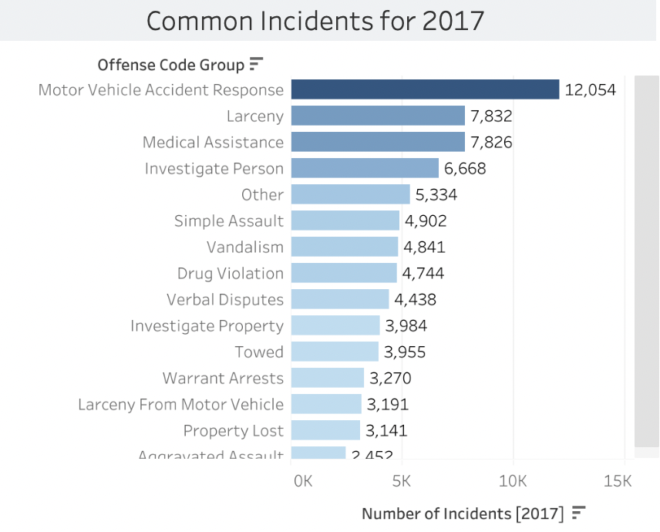
Why was Crime at an all Time High During 2017
It appears that motor vehicle accident responses, larceny, medical Assistance, and investigating persons caused the most disruption in incidents during 2017.
The top 5 crimes that were highest in 2017 include; larceny, simple assault, vandalism, drug violation, and verbal disputes.

Slide 7
Have Shootings Increased in Boston?
2015–2019
It appears that Shootings have held steady in Boston within the range 251- 457
2020
The number of shootings increased substantially to 627 from January to July.

Slide 8

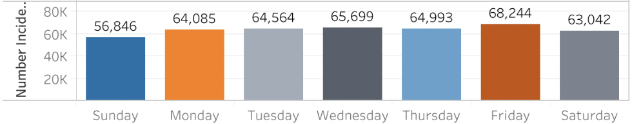
What is the Worst day to go out in Boston? What is the Best Day?
The worst day to go out in Boston is Friday. Friday holds the highest number of incidents from 2015-2020 consecutively. The average number of incidents that occur on Friday is ~12,718.
The best day to go out in Boston is Sunday.

Slide 9
What are the Top 5 Worst Districts, Reporting Areas, and Streets in Boston?
What are the top 5 worst districts to live in? Top 5 worst Reporting Area to live in? Top 5 Worst Streets to live on?
Top 5 Worst Districts | Top 5 Worst Reporting Areas | Top 5 Worst Streets
B2 - 79,816 incidents | B3 (465) - 4,400 incidents | Washington St - 25,563
C11 - 67,530 incidents | C11 (355) - 4,279 incidents | Blue Hill Ave - 13,109
D4 - 63,812 incidents | A1 (111) - 3,579 incidents | Boylston Șt - 10,279
B3 - 57,559 incidents | B2 (282) - 3,399 incidents | Harrison Ave - 8,847
A1 - 54,776 incidents | E18 (520) - 3,027 incidents | Centre St - 7,570

Slide 10
Work Cited
Roy, Sourin. (2020, July). Boston Crime Dataset (updated July 2020), Version 1. from https://www.kaggle.com/datasets/sourinroy/boston-crime-dataset-updated-july-2020?datasetId=807268

